Slide 1
SAVING MEDIA COSTS

Slide 2
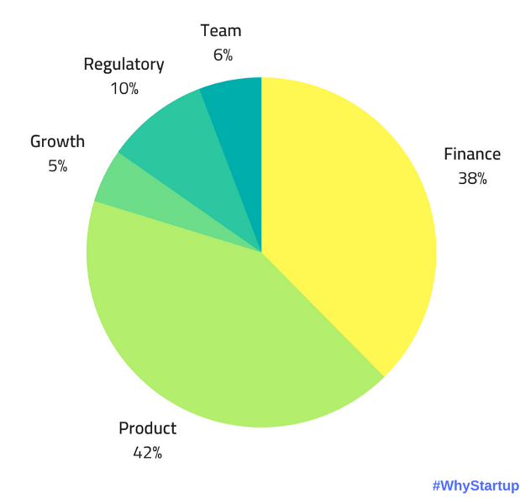
CHOOSING WHICH CITY IS THE BEST
Media companies on a budget want to provide the best content with little costs a possible
It is a uphill battle for start-ups to compete with giants
It is shown on the diagram that the main issues are products and costs

Slide 3
PROXIMITY IN DIFFERENT CITIES

Slide 4
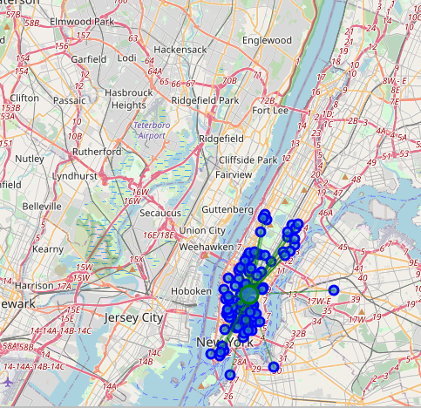
JERSEY CITY
The most clustered pizzerias are in Jersey City

Slide 5
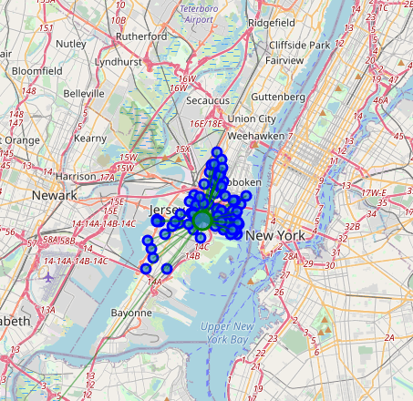
New York
A close second is New York

Slide 6
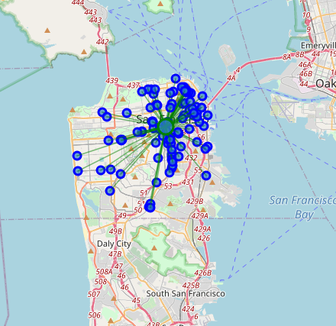
San Francisco
Close to New York is San Francisco city

Slide 7
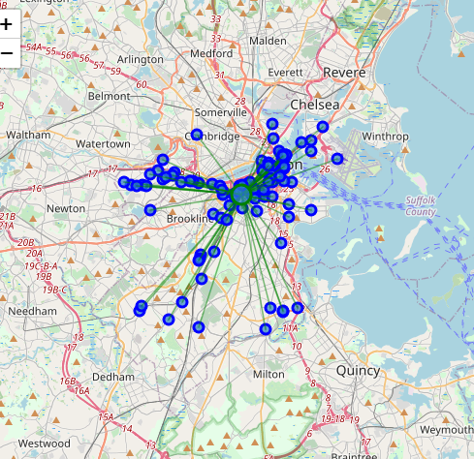
Boston
Second last is Boston

Slide 8
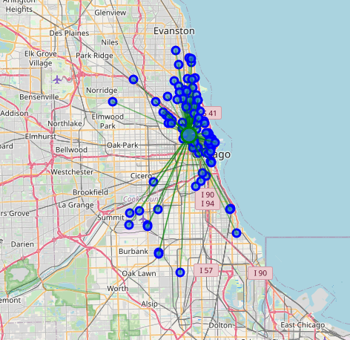
Chicago
Last place is Chicago

